Slide 1
Building a Twitter Scraper and
a Prototype Dictionary-based Sentiment Analyzer
Prof: Dr. Egbert
Class: ENG 678
Presenter: Rui Hu (Sherman)

Slide 2
In this presentation I will :
Introduce the topic
Mention the research questions
Talk about the methods
Address data and analysis
Point out challenges and limitations
Conclude the presentation

Slide 3
Introduction
Sentiment analysis
“study of people’s opinions, sentiments, emotion, and attitudes.” (Liu, 2020)
Two types of sentiment analysis
Dictionary-based sentiment analysis
Machine-learning-based sentiment analysis
Machine-learning-based model make texts lose their linguistic underpinnings
The purpose of the project was to create a prototype dictionary-based sentiment analyzer and investigate the texts from the perspective of corpus linguistics…

Slide 4
Research questions
RQ1:
What is the distribution of the ratings of the collected Tweets produced by dictionary-based and pre-trained machine-learning-based sentiment analyzer? - I will investigate the distribution of ratings
RQ2:
To what extent do the above-mentioned ratings correlate with each other? - I will investigate the correlation between the ratings

Slide 5
Methods
3 Python programs (~530 lines of code):
twitter_scraper.py & sentiment_analyzer.py &
main.py (provides friendly interface and customization options)
2 Ratings (from -1 to 1):
Produced by sentiment_analyzer.py
Sentiment: subjectivity and polarity. I will focus on polarity:
positive (rating = 1), negative (-1), neutral (0)
1 Correlation:
Between two ratings

Slide 6
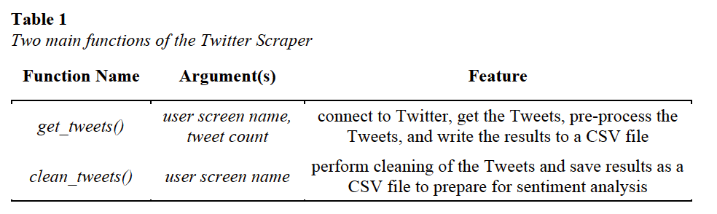
Methods - Twitter Scraper
Python Module: Tweepy
In this project:
I used 3200 Tweets collected from @abc (ABC News)

Slide 7
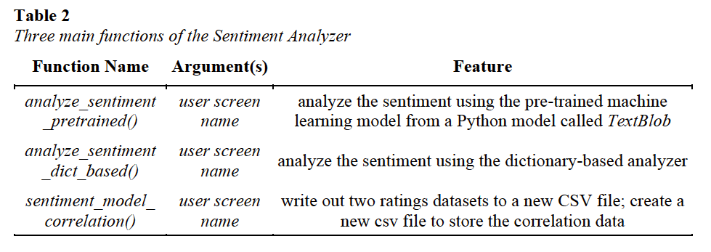
Methods - Sentiment Analyzer
Both analyzers produce ratings ranging from -1 to 1 (both inclusive)
opinion lexicons (positive words and negative words, totaling 6800 words) -
also cited in ref: http://www.cs.uic.edu/~liub/FBS/opinion-lexicon-English.rar

Slide 8
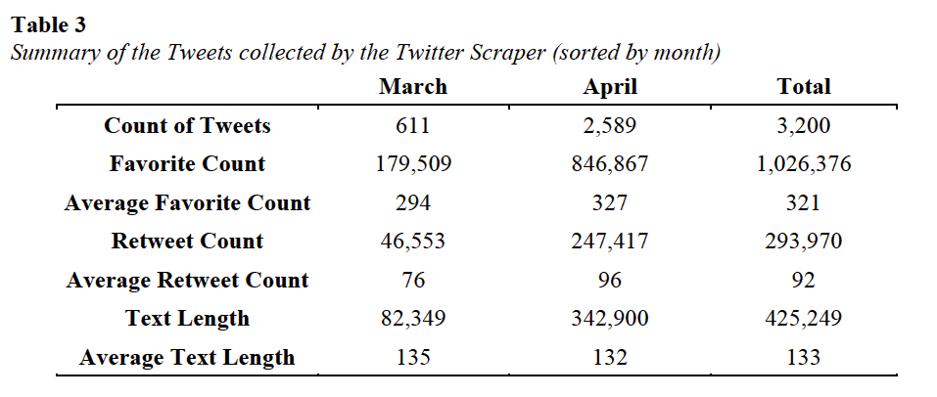
Data and Analysis

Slide 9
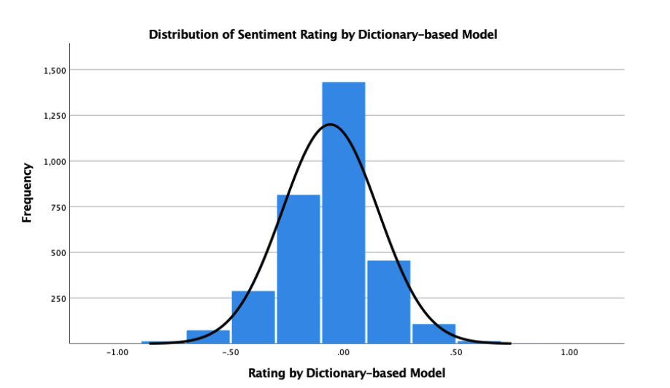
Data and Analysis - RQ1

Slide 10
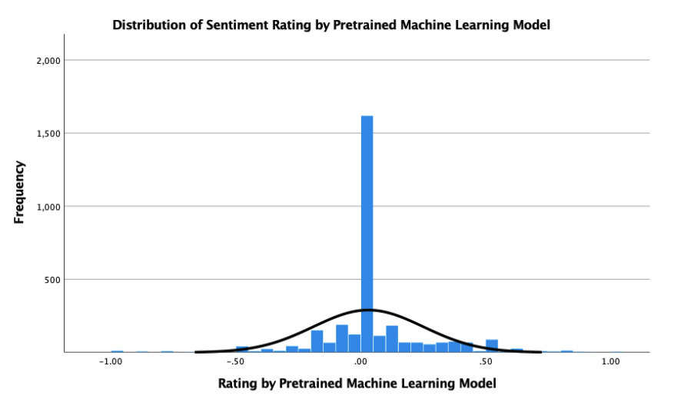
Data and Analysis - RQ1

Slide 11
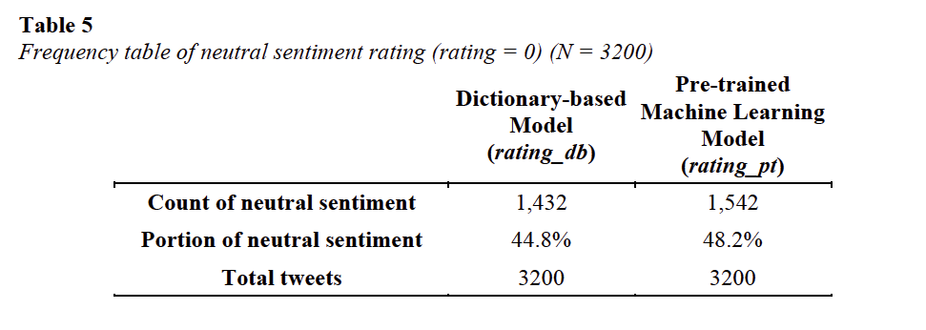
Data and Analysis - RQ1
it is safe to rudimentarily summarize that the dictionary-based sentiment analyzer has reasonable accuracy in distinguishing neutral sentiment

Slide 12
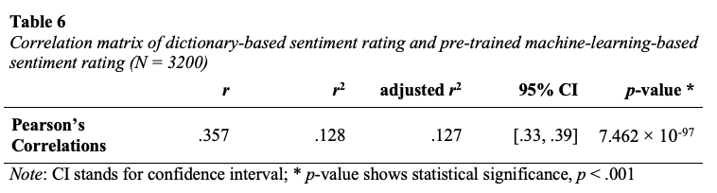
Data and Analysis - RQ2 - Produced by Python
Positive correlation
⁉️

Slide 13
Challenges and limitations
Scraping the Twitter corpus; max Tweet limit (200 -> 3200 by using cursor and pagination)
More factors should be considered:
Negation words (negative influence on rating)
Punctuations
Emoticons
Emojis
Other News Twitter accounts (Fox, CNN, CBC, CNBC) and other registers (personal Tweets by famous people)

Slide 14
Conclusion (brief)
Built a Twitter scraper and a prototype dictionary-based sentiment analyzer; applied the model pre-trained machine-learning-based sentiment analyzer
I would not declare the dictionary-based sentiment analyzer flawless -> r = .357
Shed some light on future corpus linguistics research and sentiment dictionary building

Slide 15
“You can do hard things!”
💪💪💪💪
Dr. Jesse Egbert

Slide 16
Thank you! ☺️
Any questions?

Slide 17
Python Modules (8+ main modules)
1) tweepy - Twitter scraper
2) pandas (pd) - enhanced dataframe
3) os (operating system) - for folder and file
4) datetime - current date and time
5) textblob (TextBlob) - pretrained machine learning sentiment analyzer
6) numpy (np) - enhanced scientific calculation
7) sklearn - 'MaxAbsScaler' from 'sklearn.preprocessing' - used to scale/normalize the data
8) pingouin (pg) - contains many statistic models (in this program we use this to count Pearson's r)
….

Slide 18
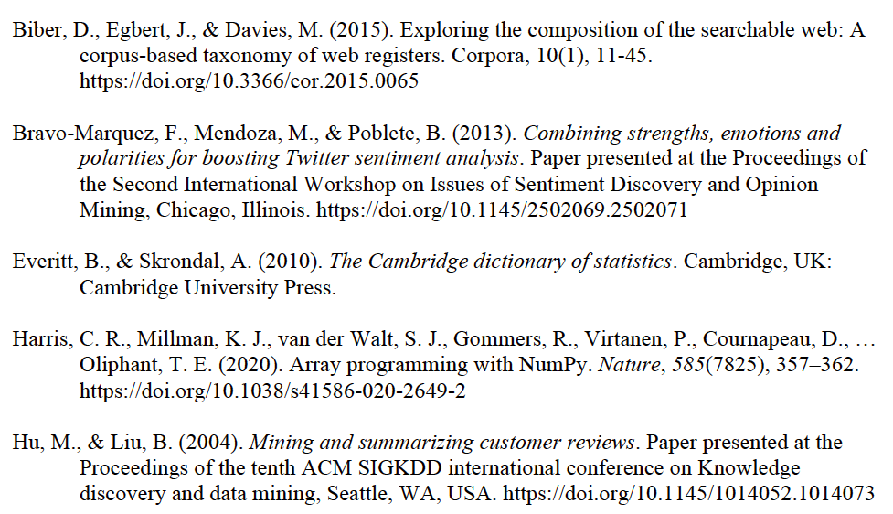
References

Slide 19
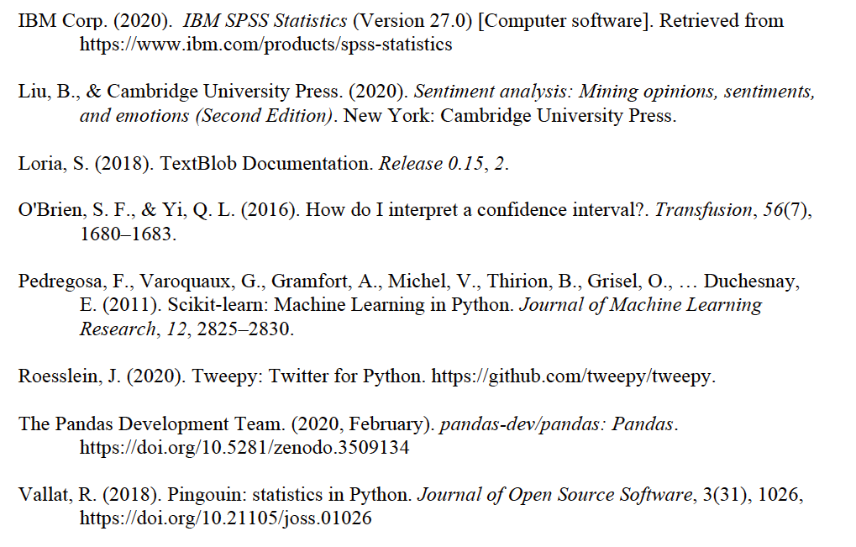

Slide 20
Supplementary Slides
(on Demand)

Slide 21
Rating of my prototype sentiment analyzer
Sentiment rating = Positive score + Negative score
(future improvement: by adding more factors/variables)
one positive word equals 1 point;
one negative word equals -1 point.
Range: infinite → [-1, 1]
Normalize: Maximum Absolute Value Method (Pedregosa et al., 2011)

Slide 22
